Slide 1
A Climate/Energy Policy for Australia
Tom Biegler
In which I explain why it would be unwise to rely on
solar and wind energy to meet future clean electricity demand

Slide 2
Who am I?
At heart a traditional sceptical scientist, researcher, mainly in basic science
Electrochemistry – that’s about batteries, fuel cells, metal extraction and refining, corrosion
10 years running CSIRO minerals division where science met heavy industrial processing
Not an energy campaigner or an activist
But long term interest in energy matters …..

Slide 3
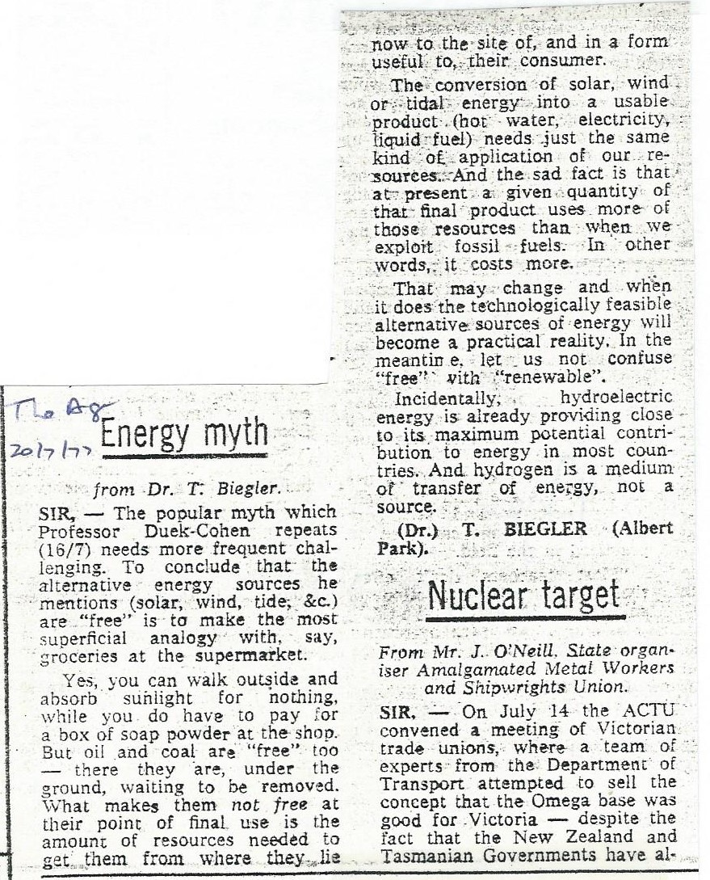
1977!
A Professor had claimed that solar, wind, tidal energy sources are free
They aren’t
He said something about hydrogen being a source of energy
It’s not
Nothing much has changed

Slide 4
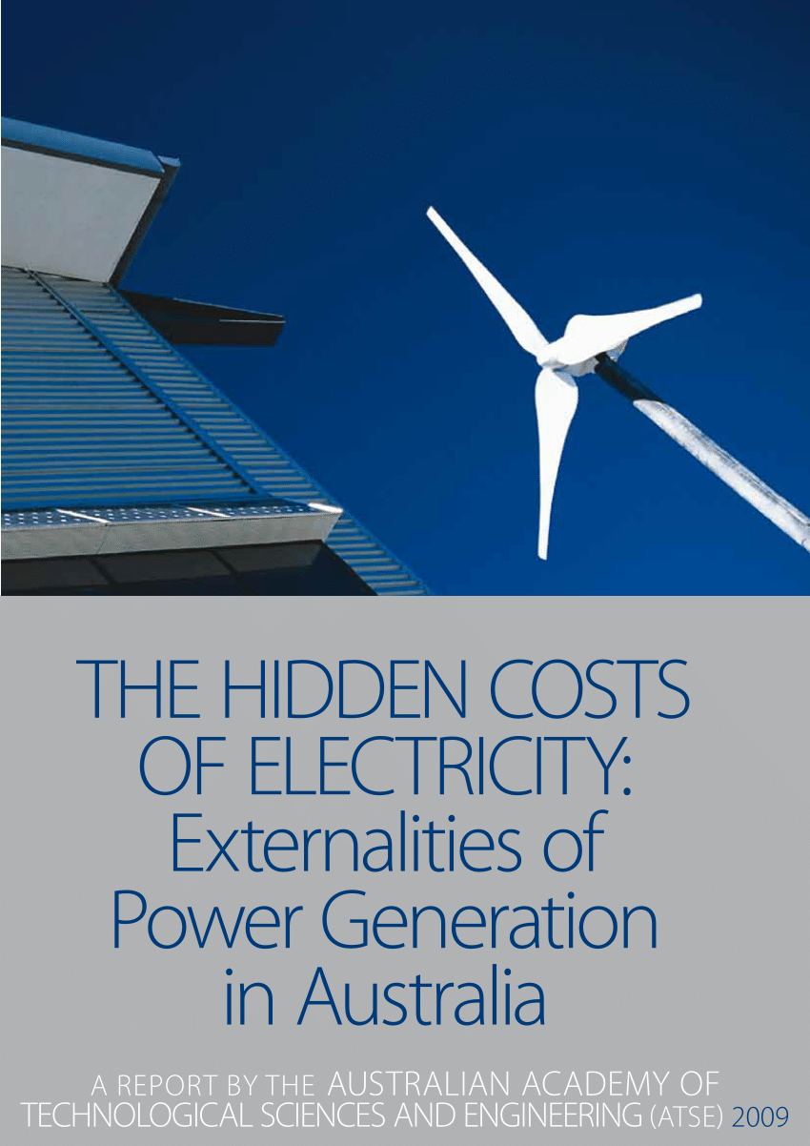
In 2009 commissioned by ATSE to report on methodology of valuing external impacts of power generation in Australia
Two years immersed in electricity technologies, emissions etc.
Apparently a much read report

Slide 5
Energy quantities
Energy quantity is a critical policy goal
Energy in physics is “the capacity to do work”
Energy quantities are measurable
There are many different units
Units are often associated with specific forms of energy
Can I say “my breakfast was 0.5 kilowatt-hour?
Yes, I can (0.5 kWh = 430 calories or 1800 kilojoules)
But it’s not a very helpful means of communication

Slide 6
Energy quantities – units and numbers
First, energy and power are different
Energy is an amount, power is a rate
“Good” measurement units help us think more clearly about the energy quantities an economy needs
Good: In 2019, total U.S. primary energy consumption was 105.7 EJ
Not so good: In 2019, total U.S. primary energy consumption was 100,165,395,000,000,000 Btu, or 100.2 quadrillion Btu (pasted from leaflet “US energy facts explained”)
For the world and large economies, exajoule EJ is a ‘good’ unit. 1 EJ = 10¹⁸ joules
For smaller economies like Australia, petajoule PJ is a ‘good’ unit. 1 PJ = 10¹⁵ joules

Slide 7
The parameters of climate/energy policy
CO₂ is the culprit
Energy usage is the main source of CO₂ emissions
Those emissions originate from fossil fuels
Clean energy must replace fossil fuels
The chosen clean energy source(s) must provide
  an abundant, secure, reliable energy supply
  with low carbon dioxide CO₂ emissions
  leading to elimination of fossil fuels

Slide 8
What is meant by “clean energy”
“Clean energy” has a special meaning
Nothing to do with dirt and smoke (though these are undesirable)
All about CO₂
“Clean” = “little or no associated CO₂”
That CO₂ is counted at every stage in producing, distributing and using energy – “life-cycle emissions”
Resulting quantity is the life-cycle emissions intensity
Here are some numbers →

Slide 9
Typical life-cycle emissions intensities for different generating technologies (IPCC) | Kg CO₂ /MWh
Black coal | 820
Gas combined cycle | 490
Solar PV utility scale | 48
Solar PV rooftop | 41
Geothermal | 38
Concentrated solar thermal | 27
Hydroelectricity | 24
Wind offshore | 12
Wind onshore | 11
Nuclear | 12

Slide 10
Clean energy sources
No source has zero emissions – yet
No specified standard but the lower the better
In practice 90 to 95% emissions reduction is considered pretty good
On that list all except the fossil fuels qualify
A clean energy world will be an all-electric world
Australia’s Chief Scientist calls it the Electric Planet

Slide 11
Australia has made its choices
There’s been talk of “technology agnostic policy”
It’s nonsense. Do a quick scan on Google. Here (and globally) renewables come up most often as the choice
The clean energy front-runners are
  Solar PV
  Wind
Policies focus on renewable energy targets
“100% renewables” is the goal
“100% renewables” is the energy slogan of the 21st century
“100% renewables” signals success

Slide 12
And success is just around the corner
Professor Ross Garnaut, April 2019
https://reneweconomy.com.au/australia-can-be-powered-100-by-renewables-by-early-2030s-says-garnaut-16846/
“I now have no doubt that intermittent renewables could meet 100 per cent of Australia’s electricity requirements by the 2030s, with high degrees of security and reliability, and at wholesale prices much lower than any experienced in Australia over the past decade.”
We can stop worrying, right?

Slide 13
Let’s see how we’re doing
AUSTRALIA: From the National Greenhouse Inventory: CO₂ emissions related to energy usage (electricity, transport, and stationary energy excluding electricity) in the two latest years were 537.5 Mt (2018) and 532.5 Mt (2019).
WORLD: (See next charts)
  emissions grew by 2.0% in 2018, faster than at any time since 2010-11
  fossil fuel use keeps rising
  CO₂ concentration in the atmosphere kept going up

Slide 14
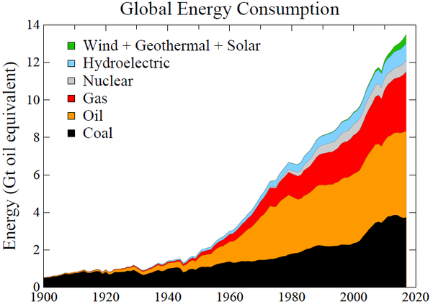

Slide 15
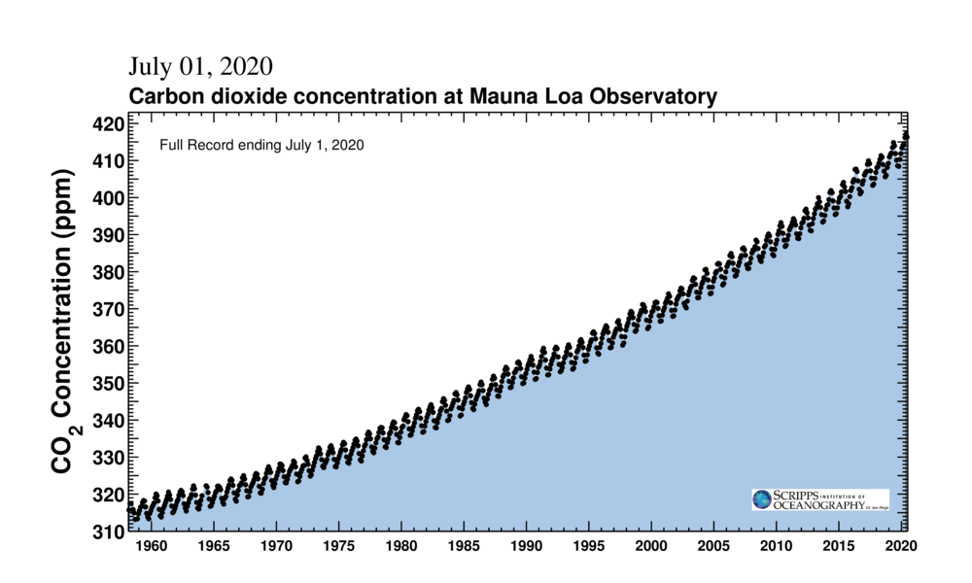

Slide 16
In other words, we’re not going too well
But it’s early days, right?

Slide 17
A deeper look at Australian energy
How are renewables performing?
What’s happening with fossil fuels?
Here’s a very informative chart
Everything in petajoules, makes easy reading (this is my compilation)

Slide 18
Australia’s latest energy statistics 2019
Energy Type | Quantity petajoules PJ
Total primary energy consumption | 6410
Total electricity generation | 954.4
Hydroelectricity | 51.9
Wind electricity | 70.2
Solar electricity | 64.6
Other renewables | 12.9
Total renewables | 199.6
Total fossil fuel primary energy | 6210
Electricity from fossil fuels | 754.8

Slide 19
Key electricity information in that Chart
It gives primary energy in form of fossil fuels
And it give total electricity from fossil fuels, from these steps:
Total electricity consumption: 954.4 PJ
Renewable electricity: 199.6 PJ (of which solar + wind = 134.8 PJ)
By difference, electricity from fossil fuels: 754.8 PJ
Which means electricity comprises 20.9% renewables or 14.1% for just solar + wind
These are the same as published data ☺
[

Slide 20
The chart also lets us work out how much fossil fuels went into generating that FF electricity
FF electricity = 754.8 PJ
Efficiency of thermal generation in Australia = 33% (this is an estimate using global average, Australia’s higher coal usage, etc)
So 754.8/0.33 = 2287 PJ fossil fuels was used in power generation
And the balance of the original 6210 PJ, i.e. 3923 PJ (63%) fossil fuels was NOT used in power stations

Slide 21
So how could cleaning up that electricity supply with 954.4 PJ of say solar + wind electricity get rid of fossil fuels?
Answer: It can’t
If tonight by magic we replaced our electricity systems with 954.4 PJ renewables (that’s 100%), tomorrow we would still be stuck with 3923 PJ fossil fuels
And that’s the problem with the 100% renewables target

Slide 22
“100% renewables” did NOT eliminate fossil fuels.
It failed, by a big margin.
So it’s very unlikely to have eliminated CO₂ emissions.
What happens with those fossil fuels?

Slide 23
Other major uses of fossil fuels
Transportation
Building heating
Cement kilns
Blast furnaces – steelmaking
Feedstocks for petrochemicals industry
Sankey diagram → (don’t try to read it, just accept there’s a huge range of essential petrochemical products)

Slide 24
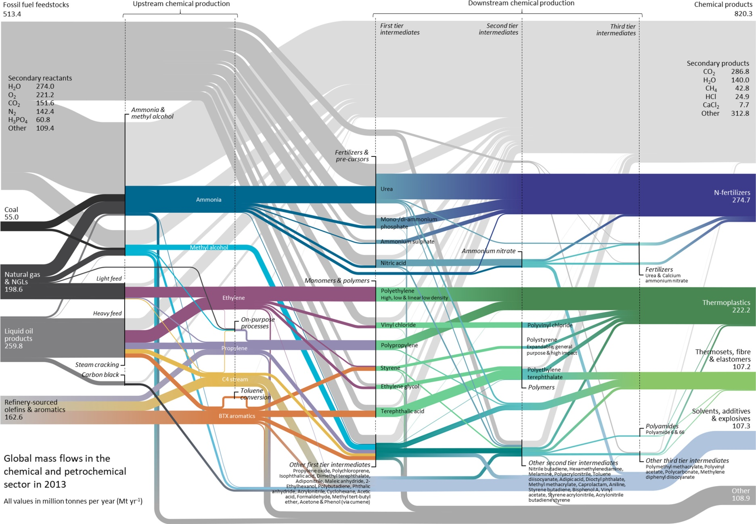
FF mass flows in chemical and petrochemical industry https://pubs.acs.org/na101/home/literatum/publisher/achs/journals/content/esthag/2018/esthag.2018.52.issue-4/acs.est.7b04573/20180310/images/large/es-2017-04573e_0001.jpeg

Slide 25
Some big items in the list
Ammonia
Nitric acid
Fertilisers
Explosives
Ethylene
Propylene
PVC
Thermoplastics
Fibres
Solvents
Polystyrene
Polyethylene
Urea
Ammonium phosphate
Ammonium nitrate
Vinyl chloride
Styrene
Ethylene glycol
Polycarbonate
Nitroglycerine

Slide 26
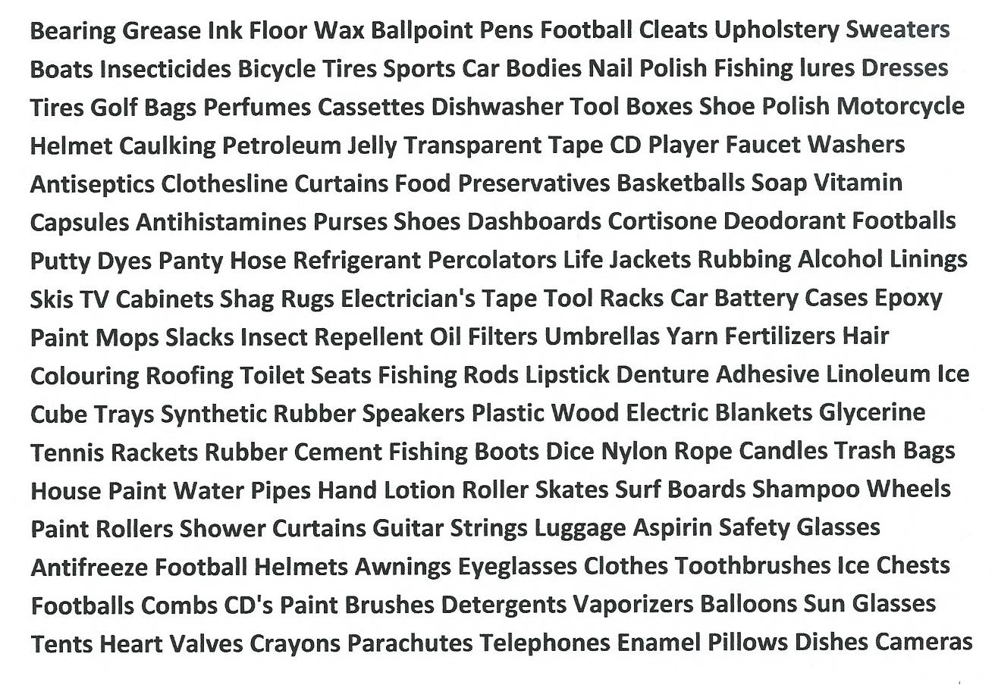
And there’s more!
A fraction of 6000 petrochemical products https://whgbetc.com/petro-products.pdf

Slide 27
THE KEY MESSAGE
In 2019 63% (3923 PJ) of Australia’s fossil fuel supply was NOT used to generate electricity
A 100% renewables electricity supply as now conceived leaves 63% of fossil fuels untouched
A 100% renewables electricity supply cannot meet primary objectives of a climate/energy policy – zero fossil fuels, zero emissions
The whole concept of clean energy targets must be revised
Those targets must be much larger to cover all fossil fuel uses and give rise to an all-electric Australia, as part of the Electric Planet

Slide 28
Now we can see the main hurdles on the track towards zero emissions
“Electrifying” every use of fossil fuels
Providing the huge additional quantity of clean electricity an all-electric economy will need
Ideally, targets based on practical alternative electrified routes for every fossil fuel use
Example – a case study for powering electric road transport

Slide 29
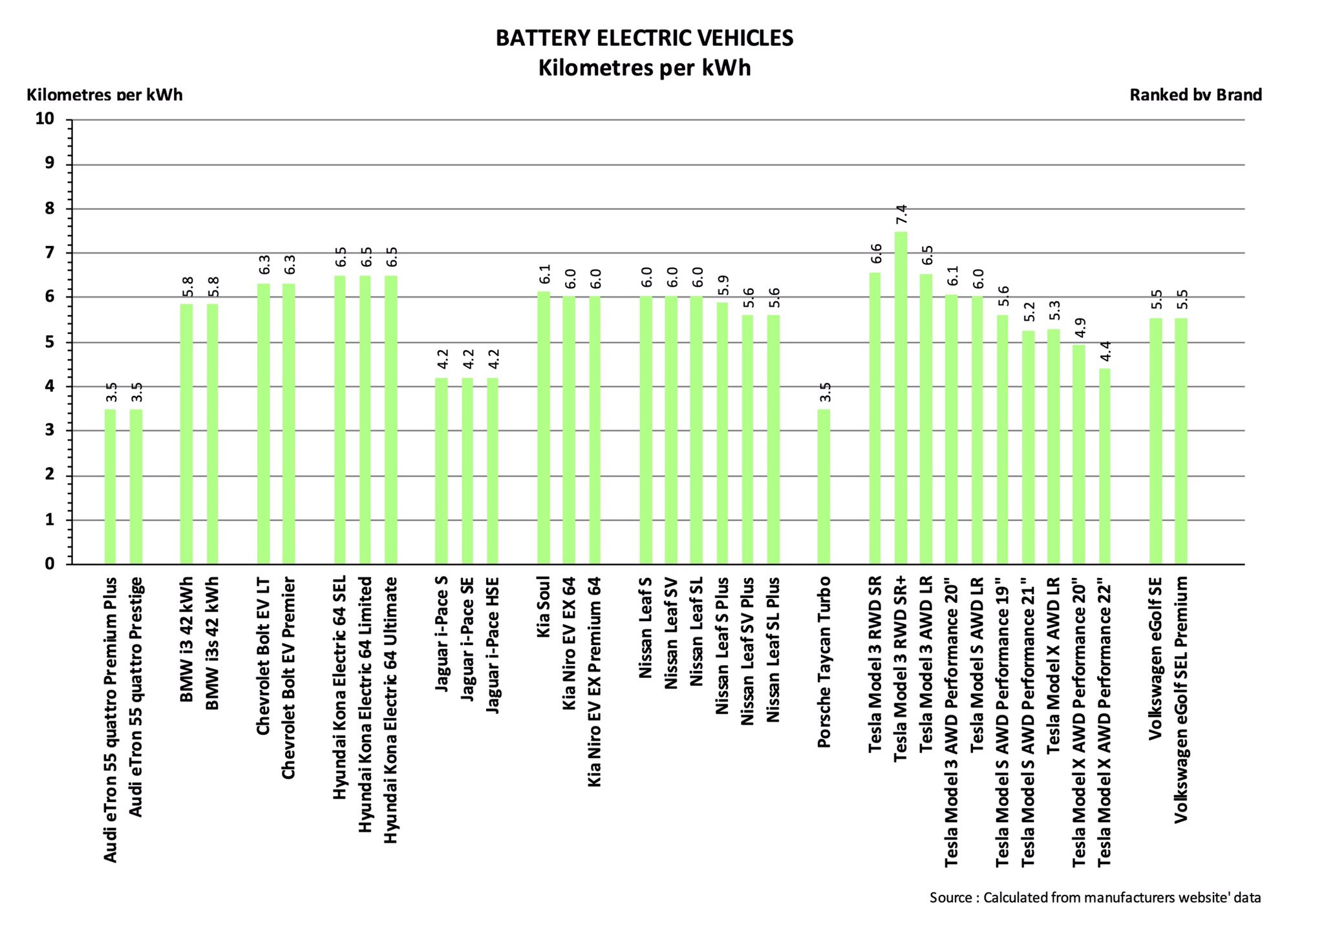
Case study: Powering electric road transport

Slide 30
Case study: Powering electric road transport
Looks like good data
Fairly narrow spread of numbers for km/kWh
Range 4.2 to 6.5. Another set gives average 5.4
Let’s say 5 km/kWh, can’t be far out
15 million cars, national average 12,600 km
Electrical energy 136 PJ

Slide 31
Case study: Powering electric road transport
Commercial vehicles, heavy transport
US data for diesel vs petrol consumption suggest an extra 43% = 58 PJ
So private + commercial road transport would add 194 PJ electrical, or about another 20% on top of present 954 PJ
Still need to add rail, air, + ??
But that gives some idea

Slide 32
Ideally, to get a reliable clean energy target a multitude of such case studies would be needed
We can’t do it the ideal way
We need a target estimate soon

Slide 33
Here’s one way to tackle the problem
In 2019, 63% (3923) PJ of Australia’s fossil fuel supply was NOT used to generate electricity
How much clean electricity to do the same jobs?
We know that 755 PJ clean electricity would get rid of the 2287 PJ FF we’re still using in power stations
Let’s just assume that proportionately more would get rid of the other 3923 PJ FF
That’s 1295 PJ more clean electricity
Which gives total needs as 1295 + 954 = 2249 PJ
About 2.4 times present electricity
Remember – it’s based on a very crude assumption. More work needed!

Slide 34
Some published estimates of electrical energy targets: World and Australia
There’s been some work on various targets
Mark Jacobson of Stanford’s WWS Project fame gives global total of 373 EJ = multiplier about 4
He also gives 3750 PJ for Australia, also about 4
MacKay says “nearly triple” for UK with addition of just heating and transport
Barry Brook (Uni of Tasmania) gives 3.6 multiplier for electrified world 2060
Zero Carbon Australia (Melbourne Uni) is a low outlier, multiplier 1.9

Slide 35
Implications of a 2250 PJ target
2250 PJ looks like a reasonable and conservative clean electricity target
It’s sufficient to change perceptions
E.g. We now have 200 PJ renewables. That’s 8.9% of the new target
Need another 2050 PJ, all from sun and wind
Solar + wind growth rate last year was a record 31.6 PJ. At that rate it would take 65 years to hit target

Slide 36
Contrast with the good news stories accompanying renewables data
“2019 was a remarkable year for the Australian renewable energy industry”
“Australian renewables growing at record rates”
“Australia could get 90% of electricity from renewables by 2040”
“Australia is the runaway global leader in building new renewable energy”
[All sources linked in policy paper]

Slide 37
There’s a gulf between reality and perceptions
The gulf is not an absolute barrier to feasibility but it should be better known
As for intermittency, all talk of storage via batteries, pumped hydro, hydrogen, etc. at this scale is speculative
Higher growth rates are indeed possible, storage may well turn out to be practical
But policy in 2020 ought not rely on such untried solutions

Slide 38
Could nuclear power add certainty?
The scale of any transition to clean electricity is staggering. Australia is just 6% or so along the track. Even then, the output will not be “industrial quality” – continuous, reliable, secure.
The sheer size of the challenge makes it unwise, to say the least, to exclude nuclear energy from the mix. Every clean technology should be in the mix.
This kind of case for including nuclear is essentially new. It’s based entirely on its role in cutting greenhouse emissions. If over the next 10 to 20 years solar and wind do better than the data used here suggest then the case for nuclear changes.
In the meantime Australia should get ready.

Slide 39
First steps towards nuclear energy in Australia
Legitimising
Developing the public case for its necessity – reliable clean energy targets, realistic monitoring of progress of renewables towards such targets.
Combatting deep-seated anti-nuclear sentiment
Ongoing consultation on public attitudes to nuclear. Why shouldn’t Australians accept prospect of a nuclear future at least as readily as the 63% of the world living in nuclear-powered nations?
Provide balanced information on the influential “too slow, too expensive” objections to nuclear energy.

Slide 40
Finally …..
Nuclear energy is a sensitive issue in Australia
I’m not a nuclear campaigner, though I’ve never accepted anti-nuclear arguments
Renewables advocates are understandably passionate
I believe they have overreached in their “100% renewables” approach
Their anti-nuclear argument is always the same – too slow, too expensive
Numbers, goals, and especially costs, should be considered in the perspective of a 20 to 50 year timeframe.

