Slide 1
QUEENSLAND: 2015 AND BEYOND
Tony Makin
Professor of Economics
Griffith Business School
Presentation to Australian Institute for Progress Forum
25 February 2015

Slide 2
The Future Does Not Look After Itself
Ignoring the future is consistent with Keynes’ famous dictum that ‘in the long run we are all dead’
Excessive government spending during the GFC has had harmful economic consequences that adversely affect us now and into the future
High public debt has crimped household and business confidence and worsened Australia’s competitiveness

Slide 3
Economic progress has stalled since the GFC ...
Income per head since 2008 has grown on average below 1% per annum
- less than half the 2% plus per head rate of the previous decade
Both federal and state budgets seriously deteriorated - Queensland’s position was the worst of all the states

Slide 4
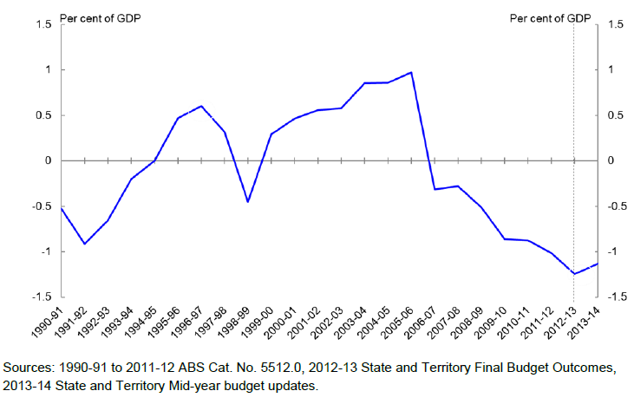
Aggregate Budgetary Position of the States

Slide 7
From mid 2000s, substantial rise in general government debt/GSP with Qld recording the biggest increase……

Slide 8
The Debt Problem
Debt is seen to be more of a problem at State level given Australia’s high Vertical Fiscal Imbalance relative to other federations
(eg Canada, Switzerland)
Even though in general the States have better balance sheets than the federal government
Debt unsustainability is always a looming risk

Slide 9
Queensland, Western Australia, South Australia and Tasmania lost AAA credit rating
Downgrades to credit ratings increase interest rates, leading to a potentially vicious circle of deficits and debt
Qld loss of AAA estimated to be costing $100m pa

Slide 11
Other reasons why public debt is a problem …..
Most public debt in Australia is owed to foreigners, hence interest is paid abroad – over $12 b per annum federal, $4 b Qld
a concern because public foreign debt is not, for the most part, backed by productive assets, and interest on the debt paid to foreigners is a net drain on national income

Slide 12
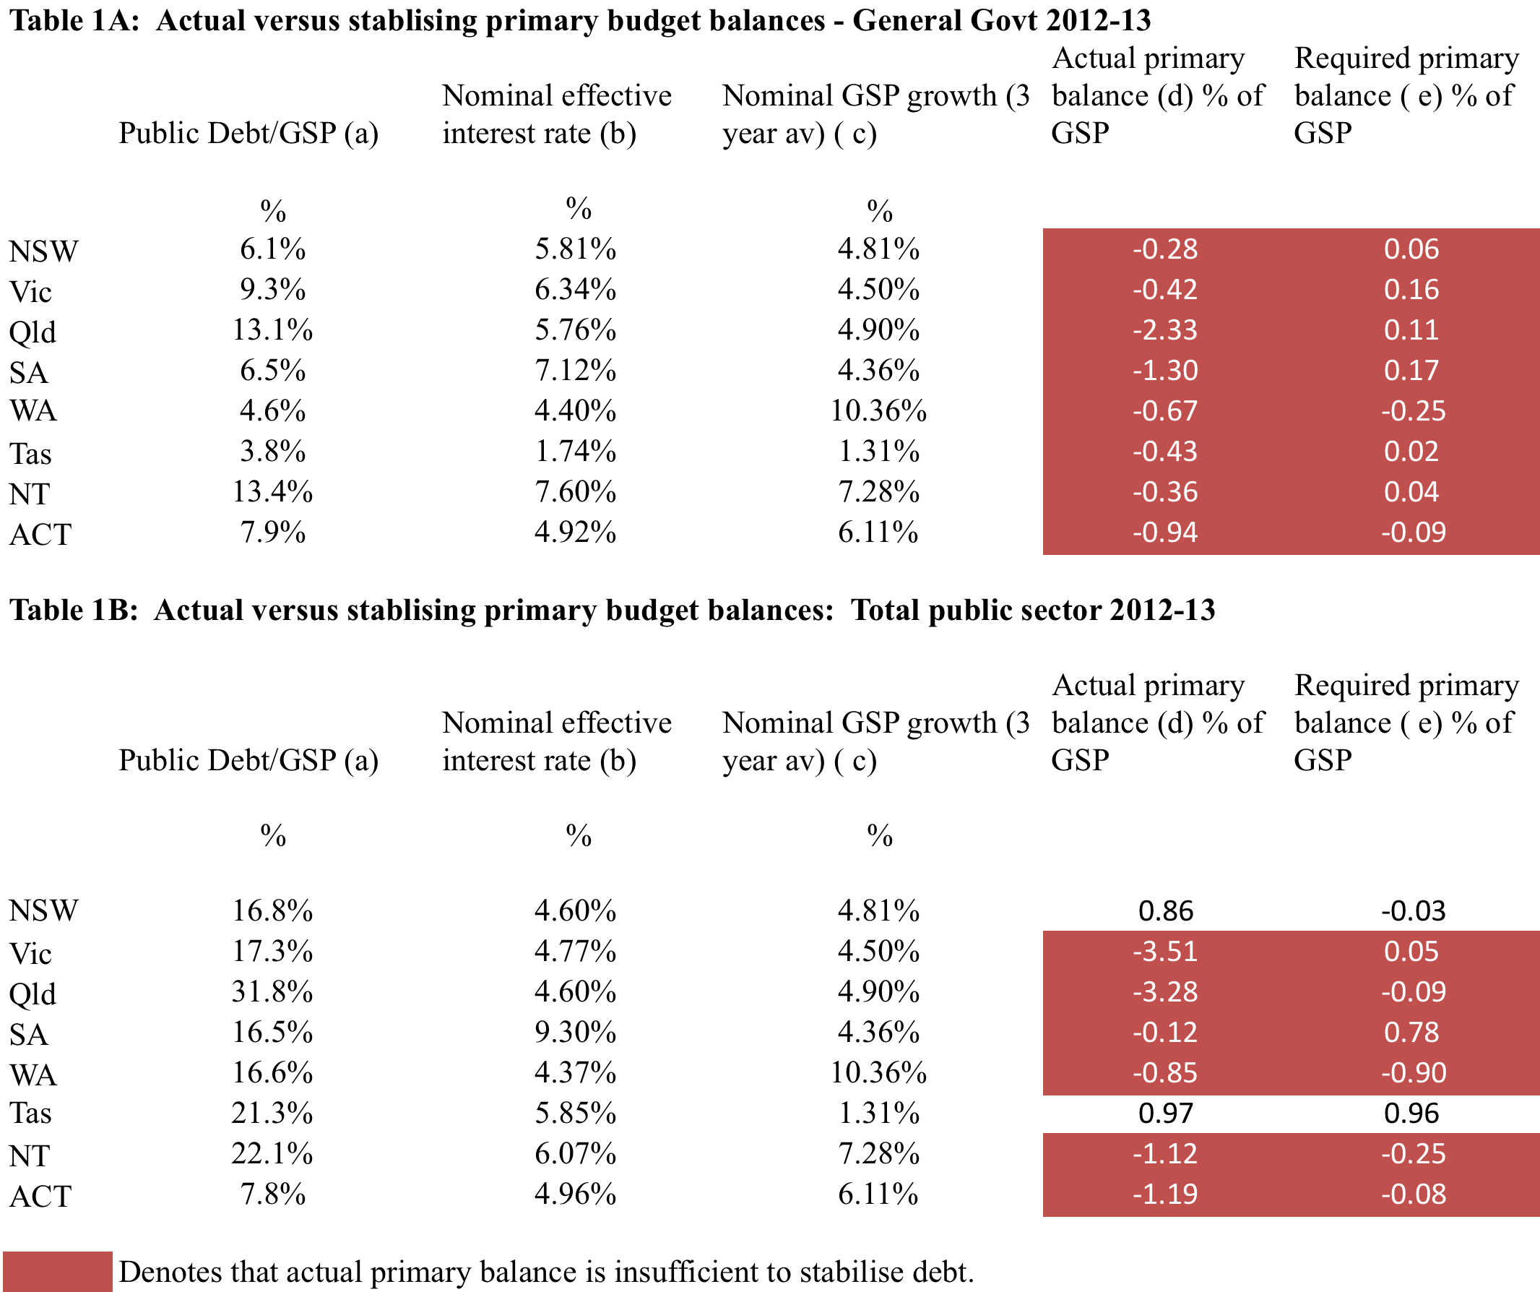
Queensland and Other States’ Debt is Still Rising ….
(Makin and Pearce 2014)

Slide 13
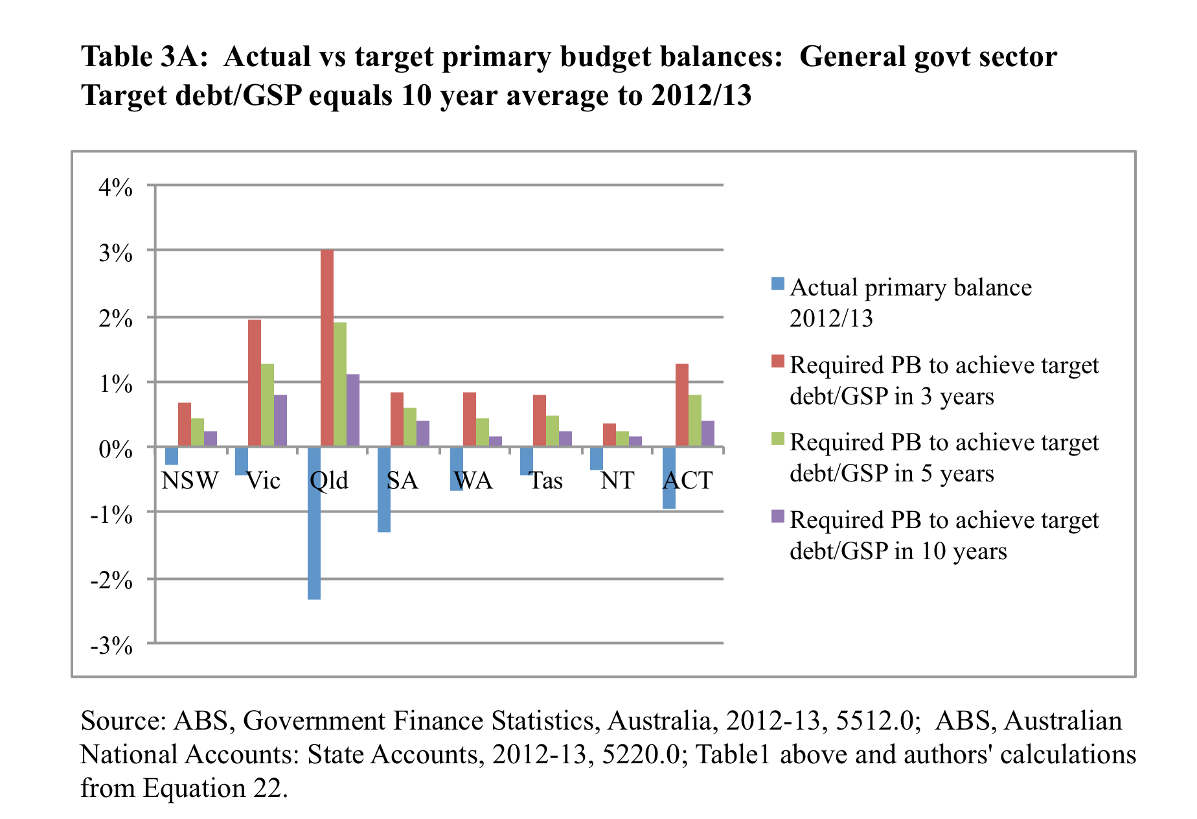
Fiscal consolidation is currently insufficient to rein debt/GSP to pre-GFC levels even in 10 years hence …

Slide 14
Future Budgetary Options
With privatisation now off the table, we are left with the following options:
Reduce federal-state program overlap
- health, education, others?
Raise taxes, but which ones?
- income tax, GST, property, payroll, estate duties?
Tailor existing programs according to key principles of public finance
- cut industry assistance
All obviously require strong political will (and a well informed electorate)

Slide 15
Thank You!

